Slide 1


Pod B
LEARNER INSIGHTS
PREPARED BY POD B

Slide 2
AFRIMENT
WHO WE ARE
AFRIMENT is more than just a learning hub; it’s a thriving community where aspiring tech professionals connect, collaborate, and grow. We provide both technical and non-technical resources to support holistic professional development.
Our vision is to inspire and empower young individuals to thrive in the global tech ecosystem, fostering innovation, building opportunities, and shaping the future of technology across the continent and beyond.
We are on a mission to create an inclusive environment where talent and potential are nurtured. By offering mentorship, skill-building program, and career pathways, Afriment is dedicated to breaking barriers and enabling young Africans to become trailblazers in the tech industry.
25,000+
ALUMNI
500+
HIRED
20+
COHORTS
30+
COUNTRIES
PREPARED BY POD B

Slide 3


BUSINESS PROBLEM
Afriment wants to understand who their learners are. What is the gender split? Which countries do they come from? What programs are most popular? How satisfied are they? And how these numbers have changed over time?
We built a complete Demographic Profile of Afriment’s Learners to spot trends that can help improve the program.
PREPARED BY POD B

Slide 4
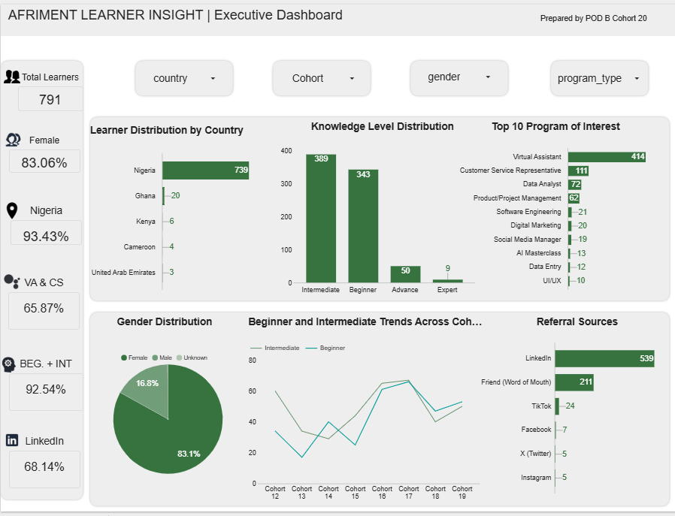
https://datastudio.google.com/s/pJj4EU4rybE

Slide 5
INSIGHTS
Branding: Afriment is strongly associated with Virtual Assistant, overshadowing its other programs.
Male Learners: Virtual assistant and Customer Support are the most preferred tracks, with most Males favoring the Internship + Mentorship pathway.
Referral Source: LinkedIn (68%) is the primary source channel across all cohorts, followed by Word of Mouth (27%). This trend is consistent across both genders.
Geographic Reach: Nigeria (93%) is Afriment’s strongest market, while Ghana (3%) is the second largest but has experienced a recent decline in participation.
Knowledge Level: About 95% of applicants are Beginners or Intermediates, though many report prior training, making self-reported experience an unreliable skill indicator.
Gender Imbalance: Female learners (83%) dominate all the cohort leaving only few male participants (17%).
Program Interest: Virtual Assistant remains the most popular program (52%), while Customer Support ranks second (14%) but has shown declining interest in recent cohorts.
The Typical Afriment Learner
The typical Afriment learner is currently a Lagos-based Nigerian female who discovered Afriment through LinkedIn. She's at the beginner-to- intermediate stage of her tech career and enrolled for the Virtual Assistant/ Customer Support.

Slide 6

BEHIND THE SCENE
The First Step was not building visuals; It was making the data useable…
Data Cleaning
8 Cohorts of waitlist and onboarding files were cleaned using Excel alongside Pod A.
Removed duplicate rows/records.
Fixed missing values.
Corrected spelling errors.
Standardized Columns, Titles, Countries, Full names.
Merging and Analysis
The waitlist and onboarding files of each Cohort was merged with SQL in other to capture variables like gender, country, program interest, knowledge level. They were analyzed and visualized with Excel, Microsoft PowerBI, Looker studio.
Peer Review Across Pods
The Learner Profile report was reviewed by Pod C and Pod D representatives. The Feedbacks were effected.

Slide 7

WHAT SHOULD AFRIMENT DO NEXT ?

Slide 8
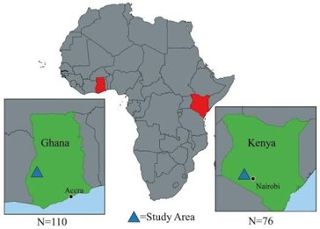

Expand into Ghana before wider African reach
Strategically expand, with focus on Ghana and Kenya as a pilot market. Gather detailed feedback from Ghanaian, Kenyan alumni through questionnaires to understand their experience, identify reasons for declining participation, and use their suggestions to improve future outreach.
Create platform-specific social media content
Develop engaging short-form content for Instagram, TikTok and Facebook. Tailoring content to each platform can improve reach and attract younger audience.
Increase visibility of technical programs
Promote lower-enrolment programs like Software Engineering, AI, and Cybersecurity through industry partnerships and career-focused campaigns like hackathons. Show clear career opportunities to make these programs more appealing to prospective learners.

Slide 9



Strengthen referral strategies
Leverage alumni testimonials and referral programs to increase awareness across social media platforms.
Brand Repositioning and Partnerships
Review the current brand identity across all official pages and websites, to ensure potential partners do not misread who Afriment is.
Then partner with universities and male-focused tech communities to increase awareness and encourage more gender balanced enrolment across all programs.

Slide 10
CHALLENGE
The available dataset did not contain enough information for the current decline in Ghanaian participation.

Slide 11
APPRECIATION
Our heartfelt gratitude goes to Afriment for giving us the platform to learn, grow and gain hands-on experience. Thank you for your guidance; every lesson and feedback has shaped us into better professionals.
To our Teammates, thank you for putting in the effort; the shared commitment and doggedness is applaudable.
THANK YOU !

